Slide 1

MACHINE LEARNING
PART I

Slide 2

Agenda
What is machine learning?
What are the two (2) main categories of machine learning?
What are some examples of machine learning?
How does machine learning “works”?

Slide 3
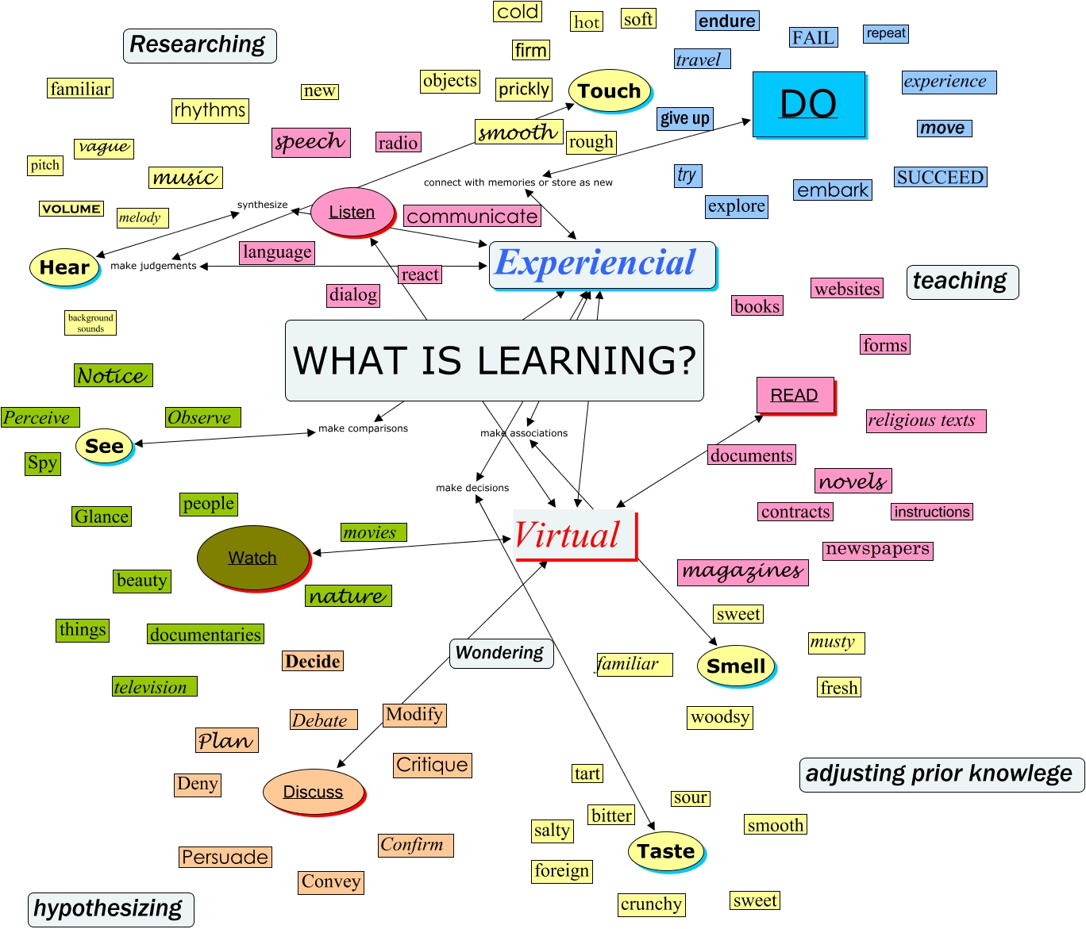
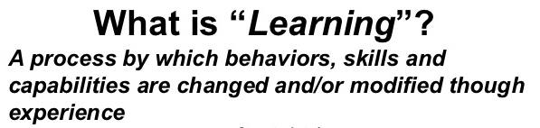
What is Learning?

Slide 4
What is Machine Learning?
“Machine learning is the semi-automated extraction of knowledge from data”
Knowledge from data – Starts with a question that might be answerable using data.
Automated extraction – A computer provides the insight.
Semi-automated extraction – Requires many smart decisions from the human.

Slide 5
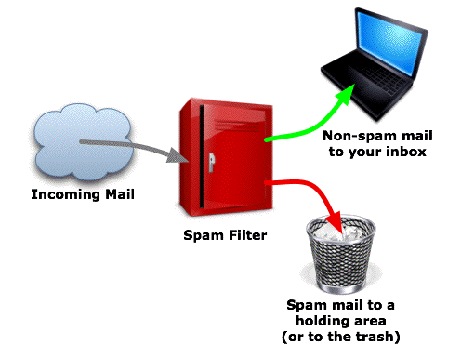
What are the two (2) main categories of machine learning?
Supervised Learning – Making predictions using data.
Example : is a given email “spam” or “ham”?
There is an outcome we are trying to predict.

Slide 6
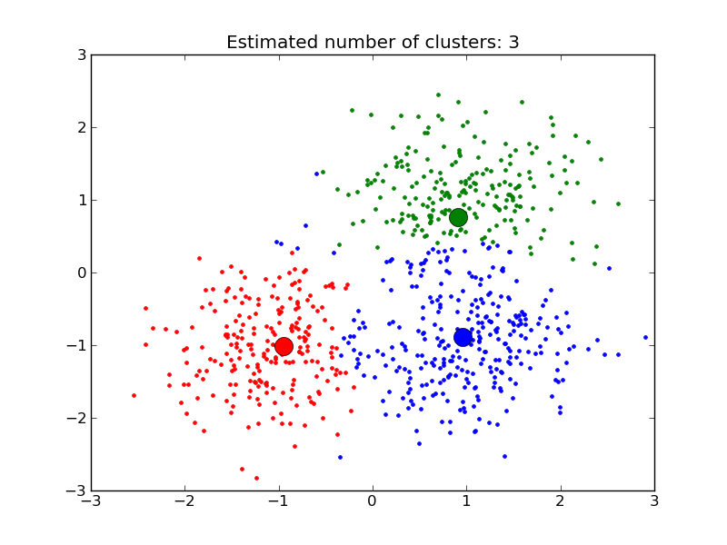
What are the two (2) main categories of machine learning?
Unsupervised Learning – Extracting structure from data
Example : Segment grocery store shoppers into clusters that exhibit similar behaviours.
There is no “right answer”.

Slide 7
QUICK QUIZ!!

Slide 8
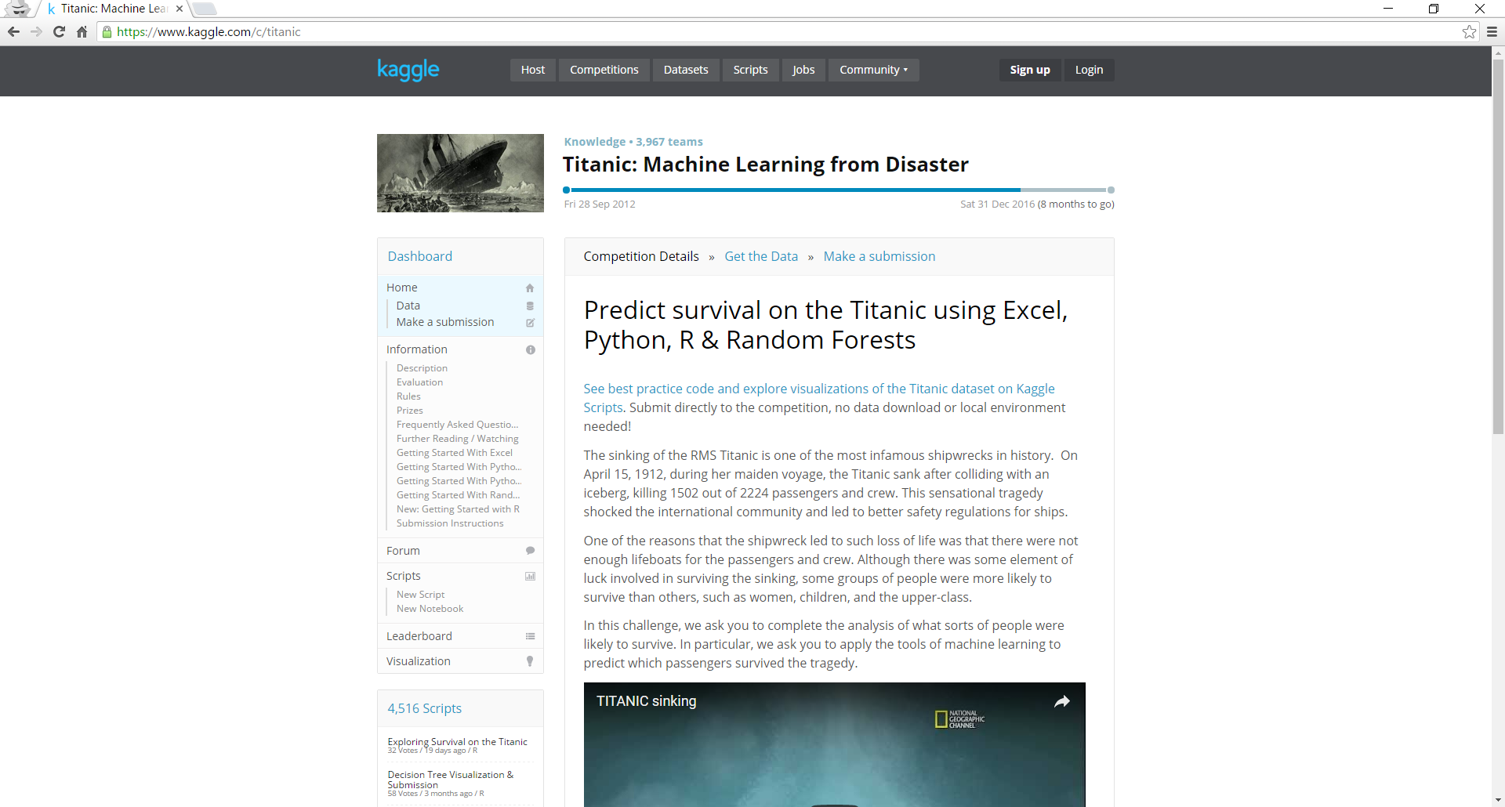

Slide 9
Take 5 before we continue with Part II of this lecture.

